Slide 1
_____ ____________ __ __ _________ / _/ | / / ____/ __ \ / // /< / ____/ / // |/ / /_ / / / / / // /_/ /___ \ _/ // /| / __/ / /_/ / /__ __/ /___/ / /___/_/ |_/_/ \____/ /_/ /_/_____/
Web Application Security
Week 1

Slide 2
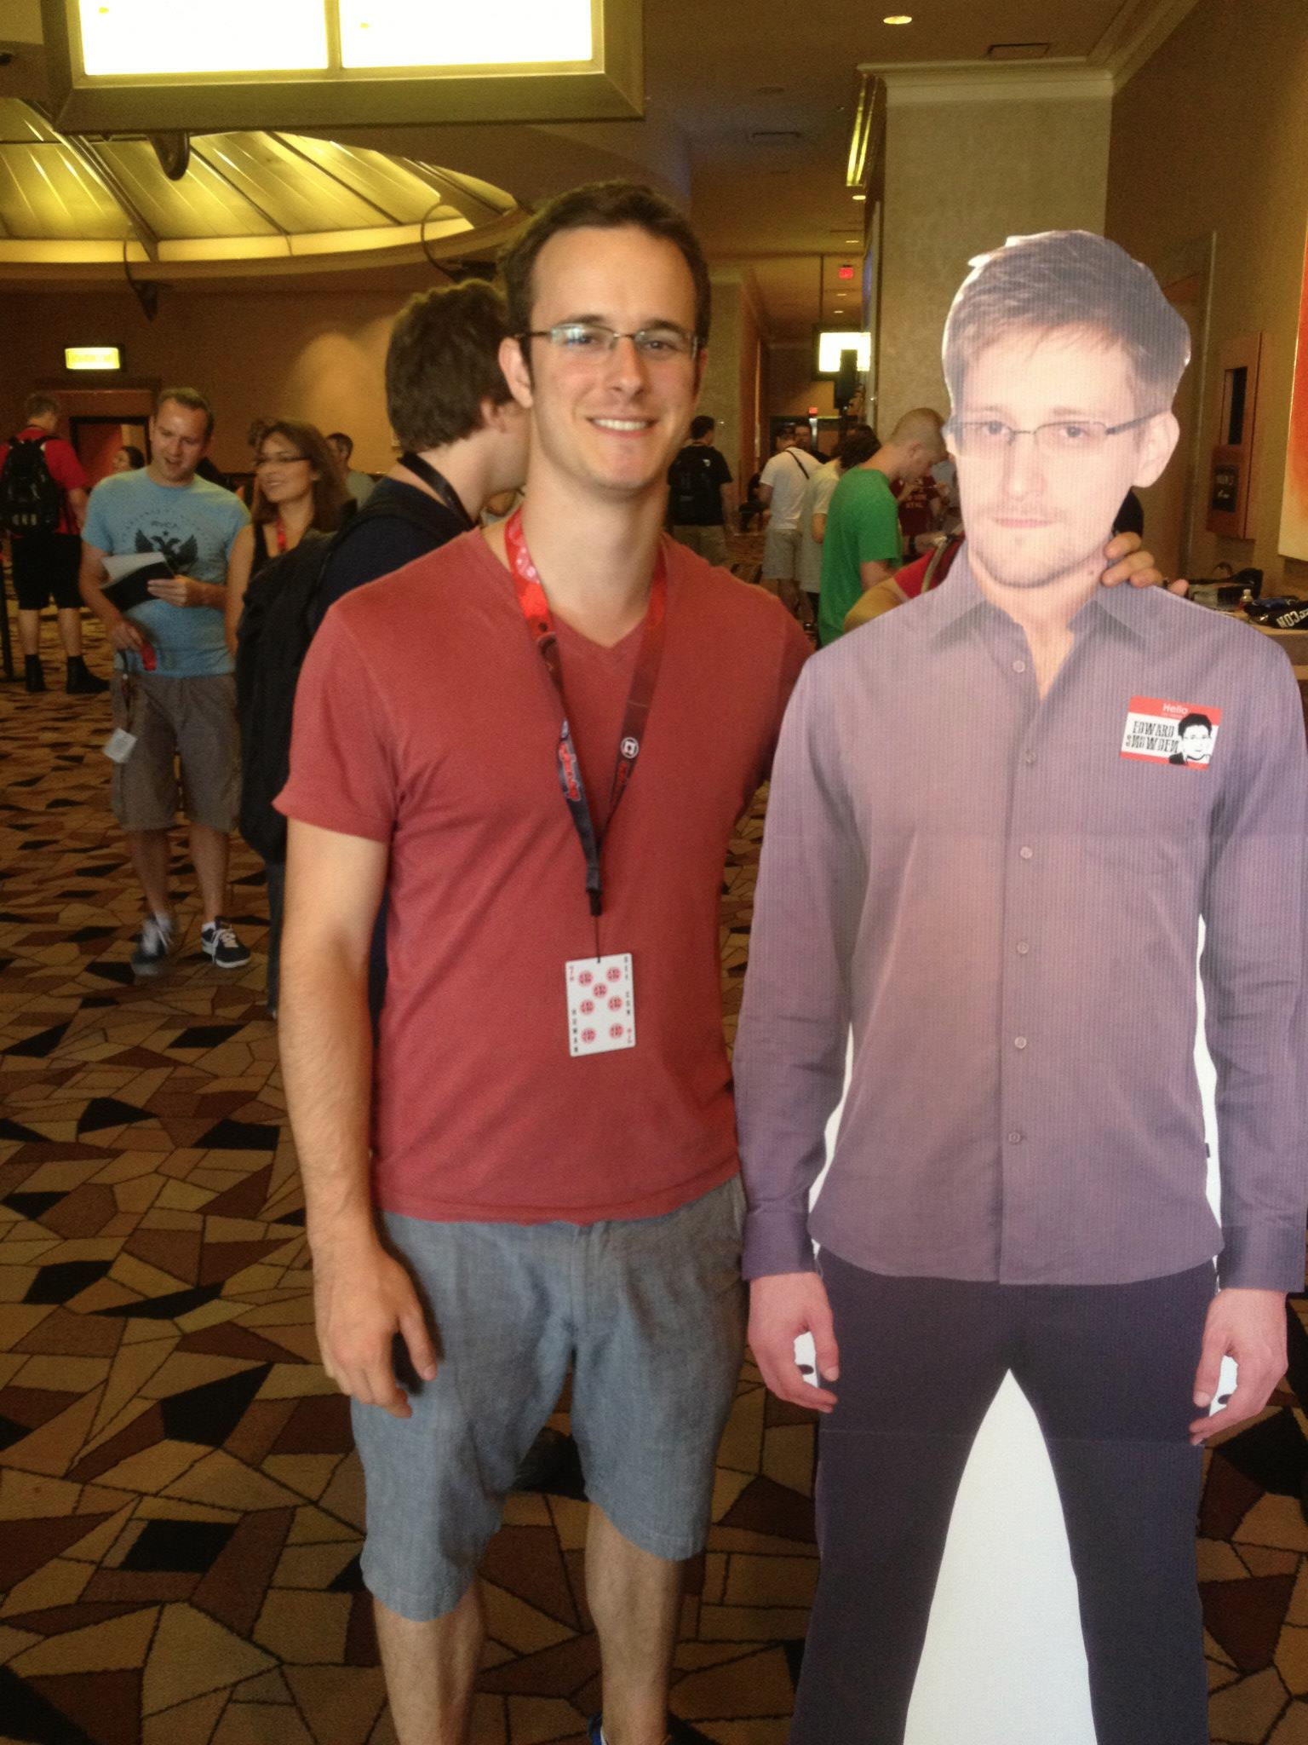





Andrew McKenna
@_amckenna

Slide 3
No one knows everything. Myself included.
I will be working full time.

Slide 4



Slide 5
The Class
Purpose is to both instruct and share knowledge
We will be hacking for reals
Recent college grad, I remember how it is
If you have a large influx of projects or exams happening all at once, please let me know
Two late day passes good for 2 days each
Late penalty: 10% daily, stops at 30% reduction
Grading
midterm: 20%
final: 30%
hw: 45%
participation: 5%
Criticism is welcome!
Ask me about unrelated security topics

Slide 6
Github
We will use github for class materials
File issues, enhancements, questions
Use github to build and display your work
We may use it to turn in work (or catalyst)
Demo

Slide 7
Where Web Application Security Fits
Malware
Network &
Infrastructure
Application Security
Physical Security
Policy & Compliance
Exploit Development

Slide 8
Sources of Security News & Learning
Honestly: twitter
https://reddit.com/netsec
https://news.ycombinator.com/
http://www.securitytube.net/
http://opensecuritytraining.info/Training.html
https://www.youtube.com/user/DEFCONConference/videos
https://recon.cx/2014/archive.html
https://www.alchemistowl.org/pocorgtfo/
http://magazine.hitb.org/hitb-magazine.html

Slide 9
Bug Bounties
https://bugcrowd.com/list-of-bug-bounty-programs
Bonus points for successful bug
10% of your earnings

Slide 10
Responsible Disclosure
Absolutely no full disclosure in this class
Legal quicksand
Be careful how you find and prove vulnerabilities

Slide 11
Tips & Tricks
Stay away from automated tools
Keep your eyes open
Send bad input
Come up with favorite testing payloads
Get an "eye" for it

Slide 12





Books

Slide 13
Anatomy of a Web Application
Frontend
Content delivered to client
HTML, JavaScript, CSS
Ajax
Middle layer
PHP, Python, RoR, Node, ASP.NET
Pages are dynamically generated
Requests parameters are parsed
Database
MySQL, MSSQL, PostgreSQL, Sqlite
Direct queries or through ORM

Slide 14
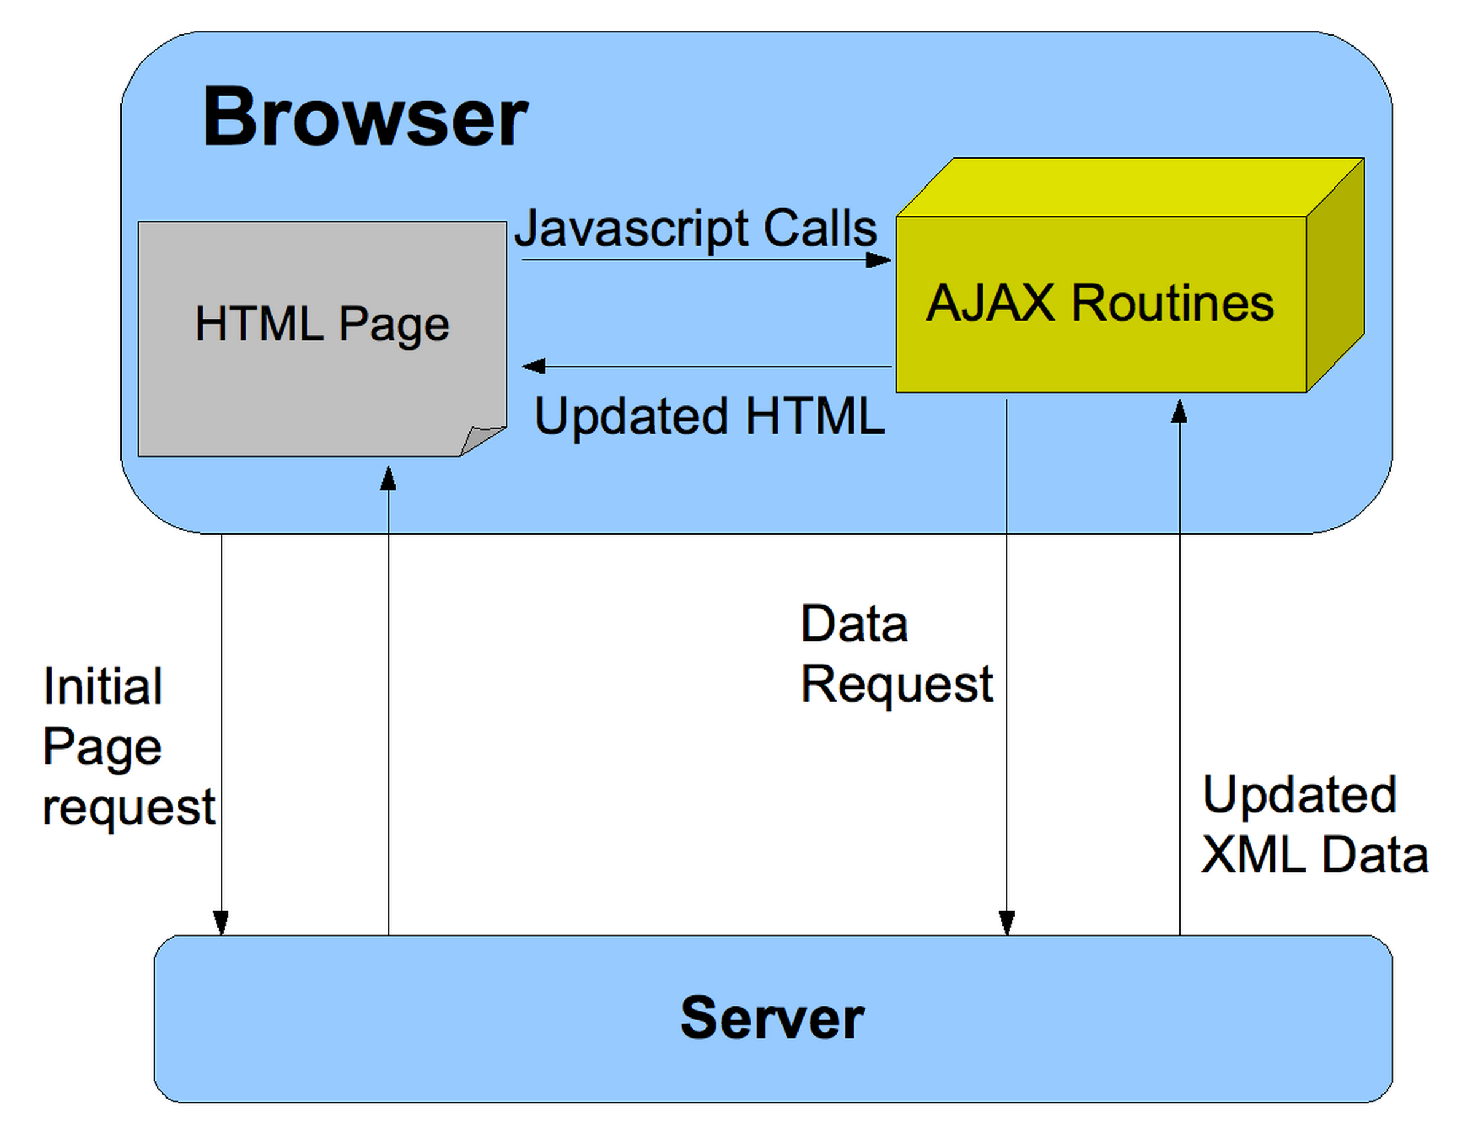

Slide 15
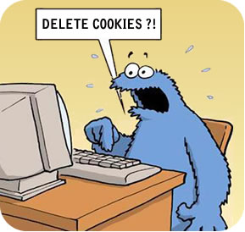
Cookies
Session management (usually)
Storage (sometimes)
Sent with every request
Essentially an ID badge
Show in Burp
Demo session sidejacking

Slide 16
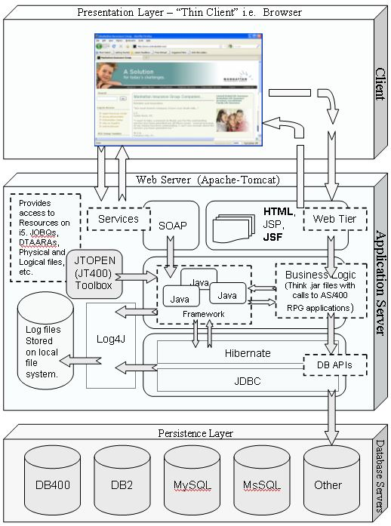
Way more happening clientside
Lots of Ajax
Lots of moving parts
Interfacing with host system more
Increase reliance on 3rd party code

Slide 17
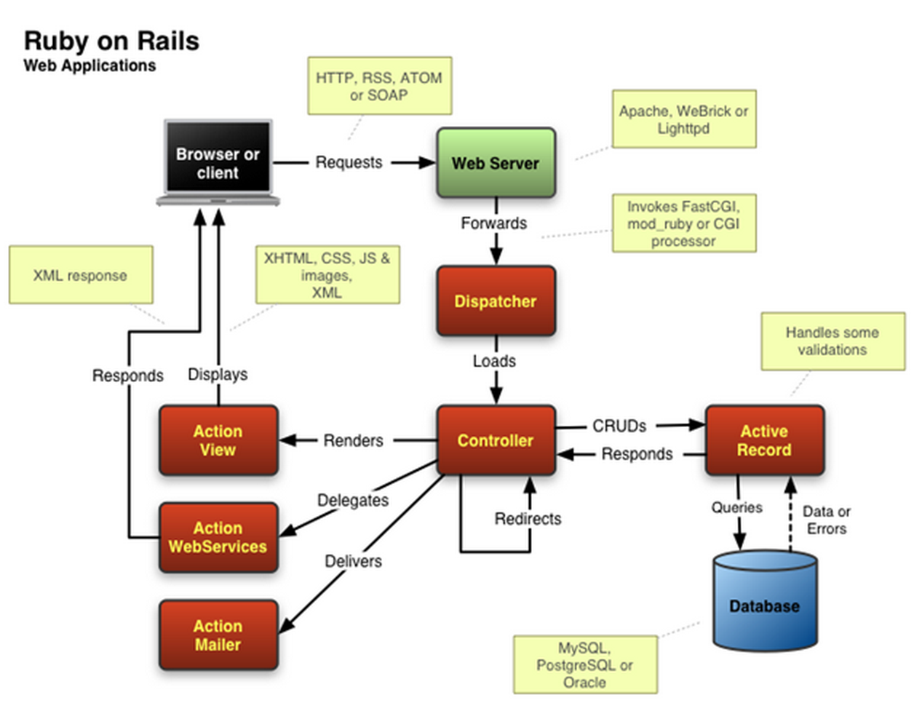
MVC Frameworks

Slide 18
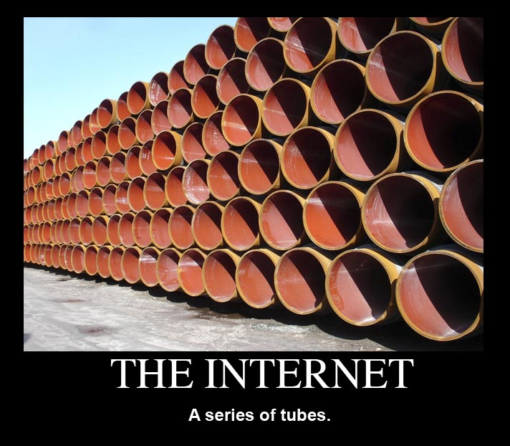
The Internet

Slide 19
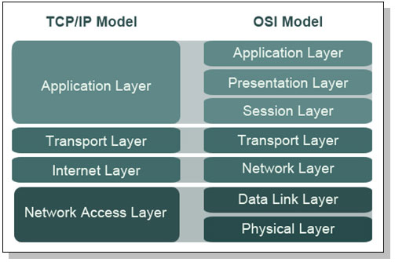
TCP/IP & OSI

Slide 20
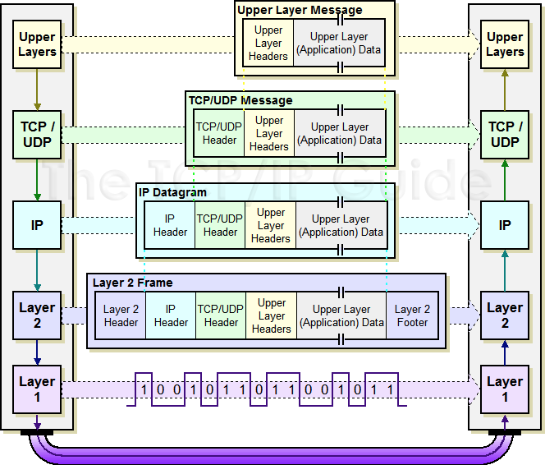

Slide 21
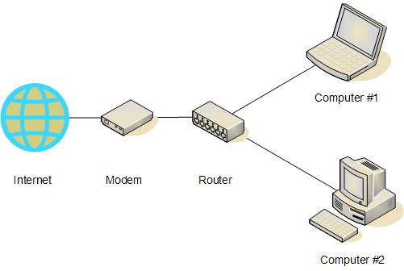
Routing
In the most basic form..

Slide 22
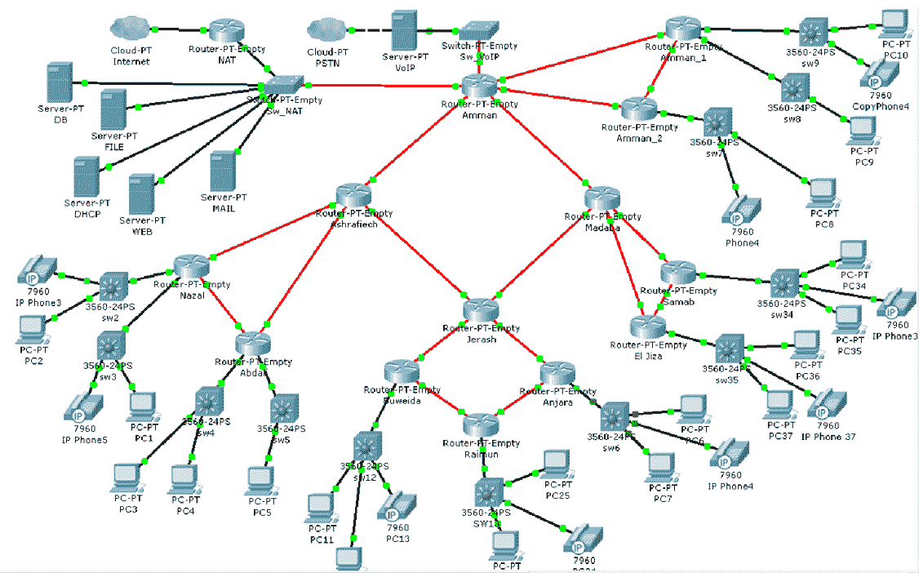

Slide 23
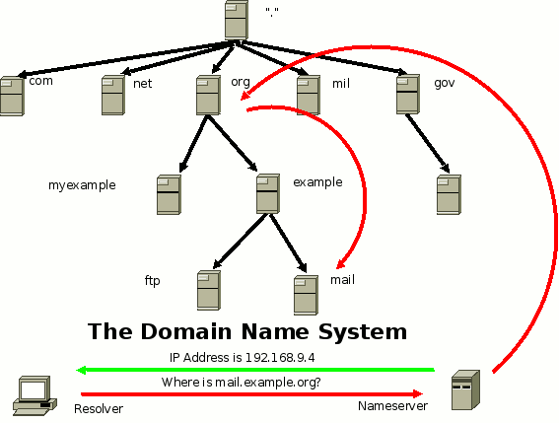
DNS

Slide 24
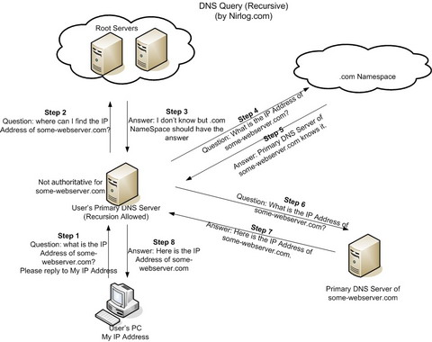
DNS

Slide 25
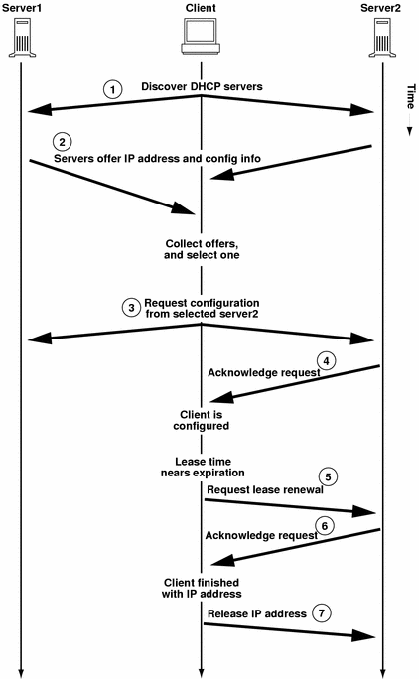
DHCP

Slide 26
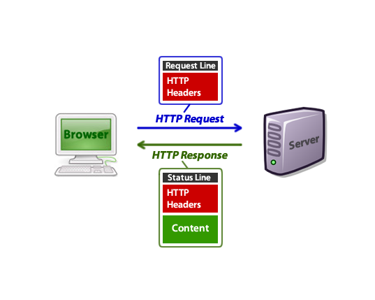
HTTP
Show in Burp

Slide 27
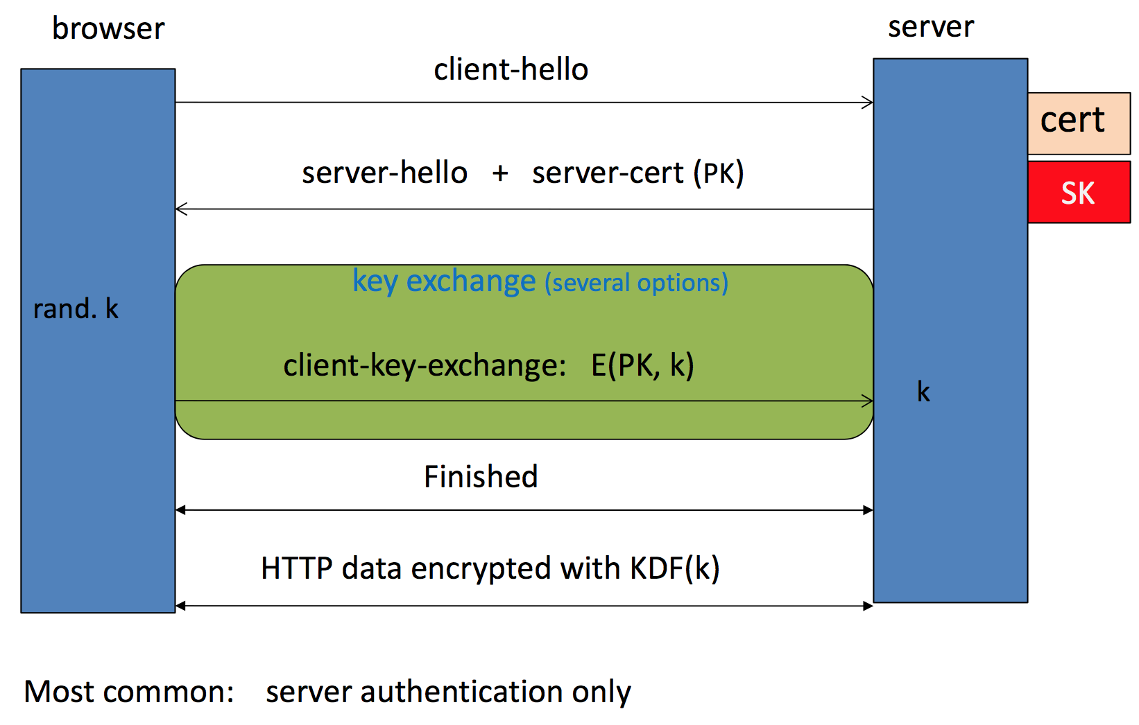
Brief Overview of SSL/TLS

Slide 28
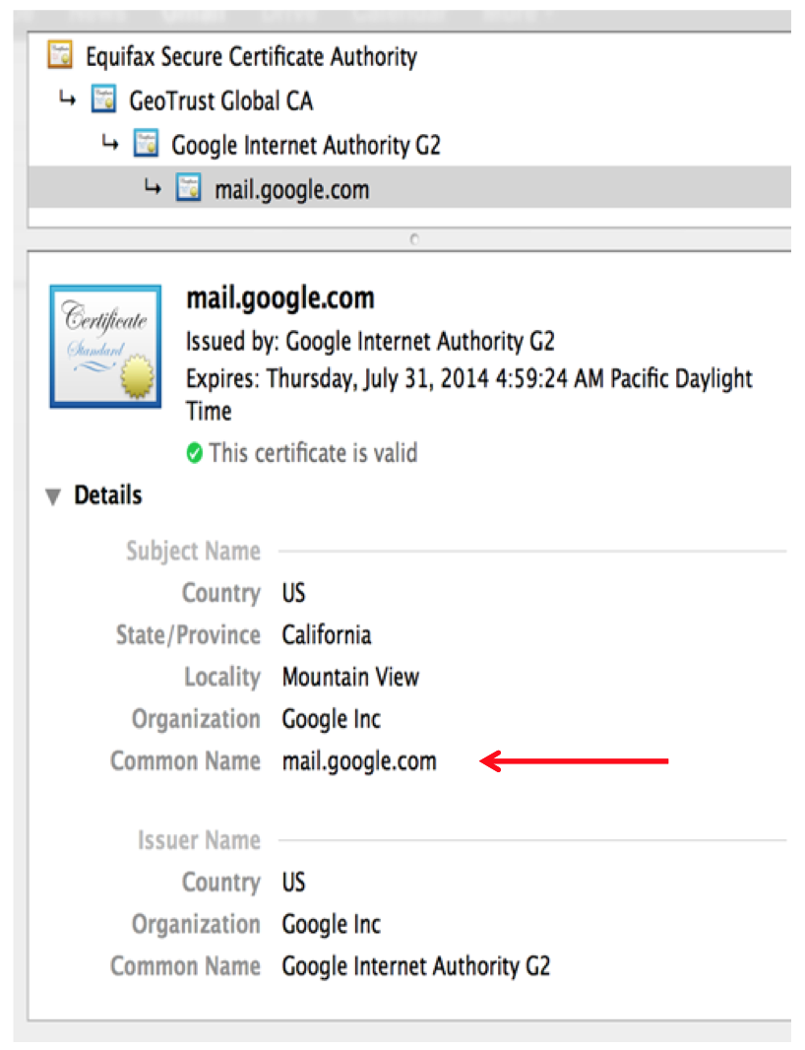
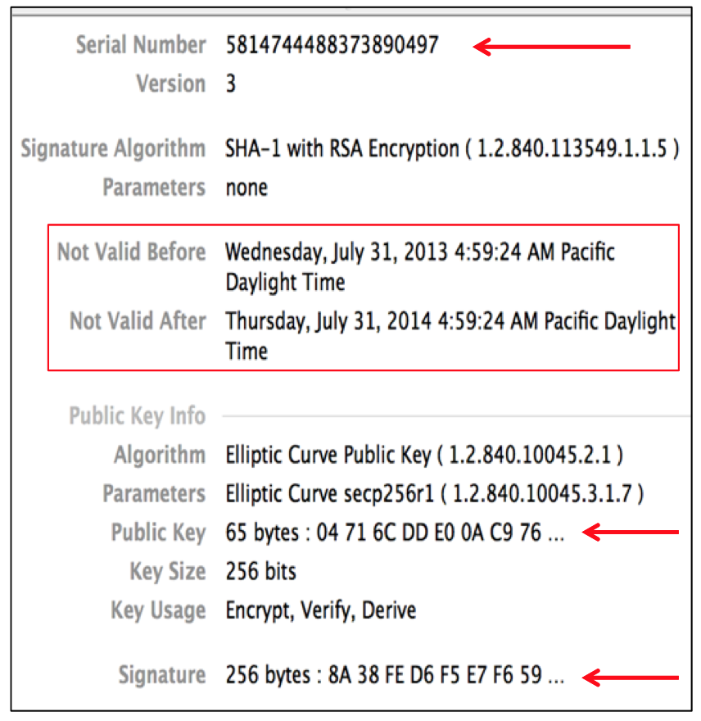
Certificates
Important Fields:

Slide 29
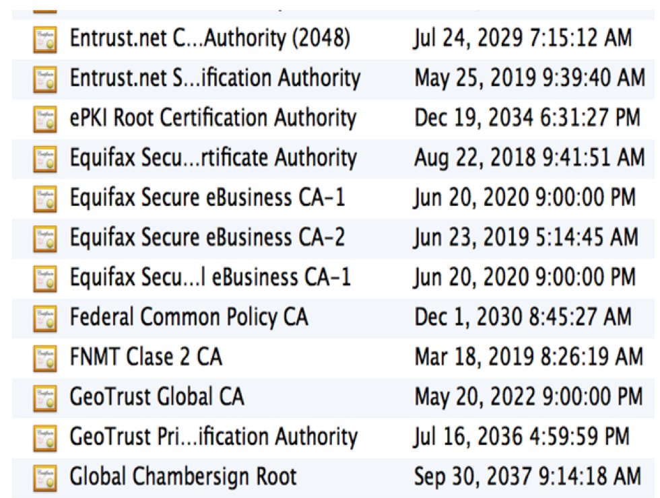
Certificate Authorities
Browsers accept certificates from a large number of CAs
Top level CAs ≈ 60
Intermediate CAs ≈ 1200

Slide 30
